Slide 1

Team Members
Mo'men Mohamed Aref
Marley Medhat
Ramez Asham

Slide 2
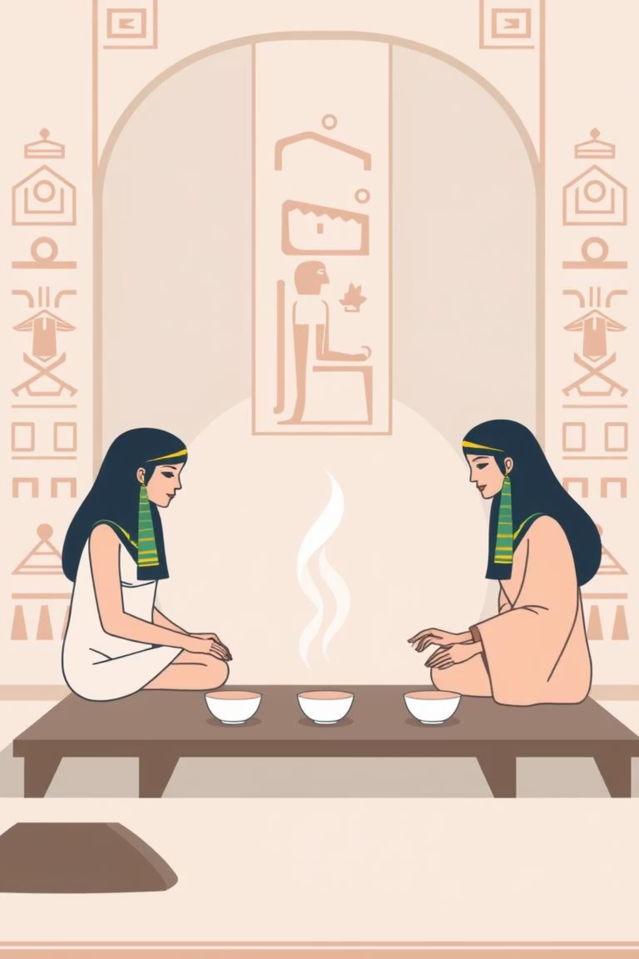
Khamseena Programming Language
Tagline: "Code it simple, brew it smooth!"
Khamseena is a beginner-friendly programming language inspired by the Egyptian "khamseena tea" – small, simple, and effective. It uses everyday English words related to making tea and simple actions to make programming intuitive and fun for kids and beginners.

Slide 3
Khamseena Keywords: Brewing Code
brew
recipe
Program start (main)
Function definition (function/def)
count
measure
Integer variable (int)
Float/Double variable (float/double)
label
switch
String variable (string)
Boolean variable (boolean)

Slide 4
Khamseena Keywords: Actions & Logic
serve
pour
Output/Print
Input/Read
taste
refill
If condition
Else condition
stir
mix
While loop
For loop

Slide 5
Khamseena Keywords: Advanced & Utilities
deliver
fetch
# note:
Return value
Include library
Single line comment
hot
cold
True value
False value

Slide 6
Data Types in Khamseena
count
Integer number
count score = 10;
measure
Decimal number
measure price = 25.5;
label
Text string
label name = "Ahmed";
switch
Boolean value
switch ready = hot;

Slide 7

Code Example: Hello World
fetch basics
recipe brew() {
serve "Welcome to Khamseena!";
deliver 0;
}
This simple program fetches basic functionalities, defines the main "brew" function, serves a welcome message, and then delivers 0 to indicate successful execution.

Slide 8
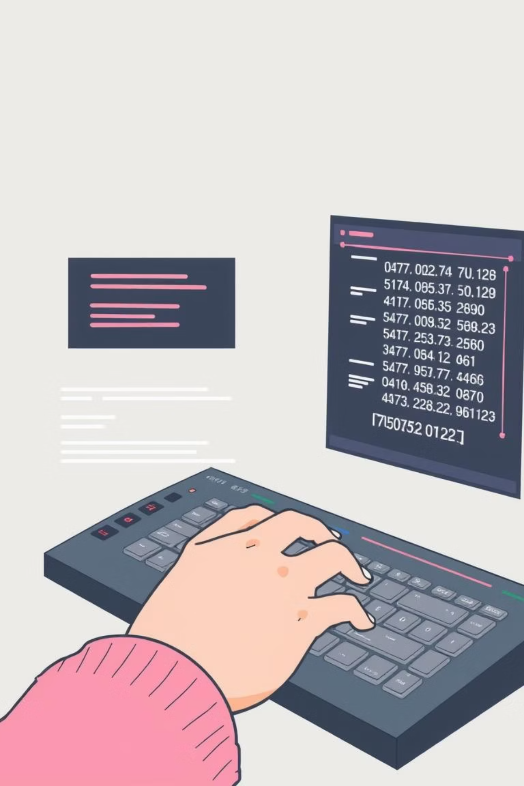
Code Example: Variables & I/O
fetch basics
recipe brew() {
label name;
count age;
serve "What's your name? ";
pour name;
serve "How old are you? ";
pour age;
serve name + " is " + age + " years old";
deliver 0;
}
This example demonstrates declaring variables, taking user input with pour, and displaying combined output using serve.

Slide 9

Code Example: Conditions (taste & refill)
fetch basics
recipe brew() {
count grade = 85;
taste (grade >= 50) {
serve "Congratulations! You passed";
}
refill {
serve "Try again next time";
}
deliver 0;
}
The taste keyword checks a condition, executing the first block if true. If false, refill provides an alternative path.

Slide 10

Code Example: Loops (stir & mix)
While Loop (stir)
For Loop (mix)
fetch basics
recipe brew() {
count counter = 0;
stir (counter < 5) {
serve "Count: " + counter;
counter = counter + 1;
}
deliver 0;
}
fetch basics
recipe brew() {
mix (count i = 1; i <= 3; i = i + 1) {
serve "Round number " + i;
}
deliver 0;
}
stir repeats actions while a condition is true, like stirring tea. mix iterates a set number of times, similar to a for loop.

